Slide 1
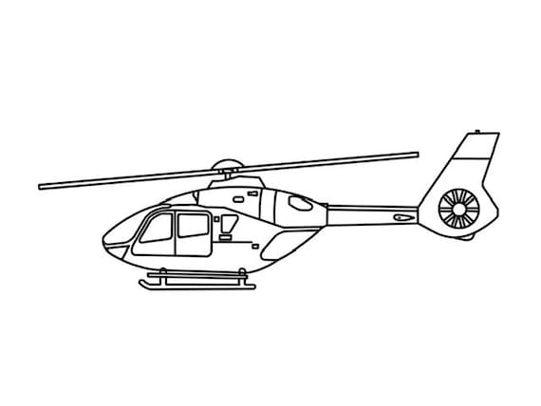
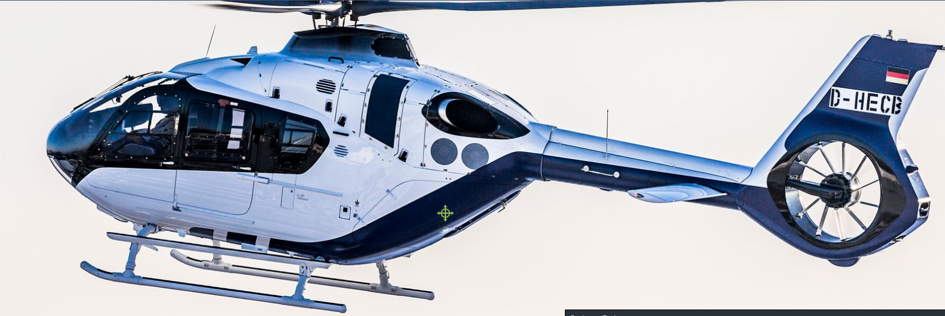
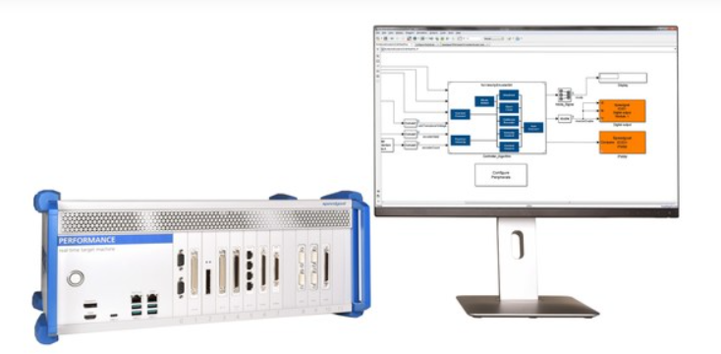
LSTM reduction of a Gas Turbine for Real-Time simulation
Ioannis Myrsinias Engineering Development Group
14/11/2023
Notes:
Good morning everyone, and welcome to our webinar today. I am delighted to share with you an exciting journey that takes us from a published article through a reduced-order model, to its real-time simulation on Speedgoat.
Real-time simulations of real-world systems offer immense potential for revolutionizing hardware in the loop testing and predictive maintenance control. By utilizing accurate digital twins, these simulations can significantly reduce design and prototyping costs while expediting the production of real systems. However, the challenge lies in the limited computational resources, which can pose a barrier to the complexity of real systems that we can simulate in real-time. This is where reduced-order models play a crucial role in reducing complexity with reasonable accuracy.
Bonjour à tous, bienvenue à notre webinaire aujourd'hui. Je suis ravi de partager avec vous un voyage passionnant qui nous emmène d'un article publié à un modèle à ordre réduit, déployé pour une simulation en temps réel sur Speedgoat.
Les simulations en temps réel de systèmes physiques peuvent ouvrir la voie aux tests matériels en boucle fermée, au prototypage rapide et à la maintenance prédictive, réduisant ainsi les coûts et le temps des systèmes réels. Cependemt Les ressources de calcul limitées constituent une barrière à la complexité des systèmes physiques que nous pouvons simuler en temps réel. C'est là que les modèles à ordre réduit jouent un rôle important en réduisant la complexité avec une précision raisonnable.

Slide 2
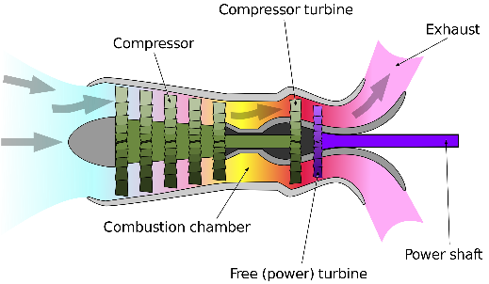
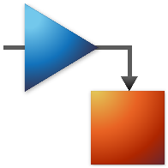

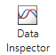
From a published article to real time simulation
Compressor
Compressor turbine
exhaust
model
emulate
Combustion chamber
Power shaft
Free power turbine
2.5% relative tolerance
40% faster
reduce
deploy
compare
Notes:
Today our journey will take us from a published article on how to model a turboshaft engine of a helicopter, to its reduction and its real-time simulation. We will walk through each step of this workflow using MATLAB and Simulink.
Inspired by the published paper we will create an equivalent physical model in Simulink using Simscape components to model the operation of a turboshaft engine
Then We will simulate it user different scenarios to generate data.
Data of which we will use in data driven AI technics to create a reduced order model. Data driven technics are getting more and more attention since nowadays and this can be a good showcase of the capabilities and performances of LSTM recurrent networks
Then we will compare the ROM with the physical model in terms of
How precise and how performant it is
We will generate code and deploy it on a real time computer to emulate its response.
Let’s get started
Les résultats que nous avons obtenus sont vraiment remarquables : une réduction de 30% du temps de simulation et une précision quasi parfaite d'environ 98% pour notre modèle à ordre réduit.
Dis par rapport du background

Slide 3
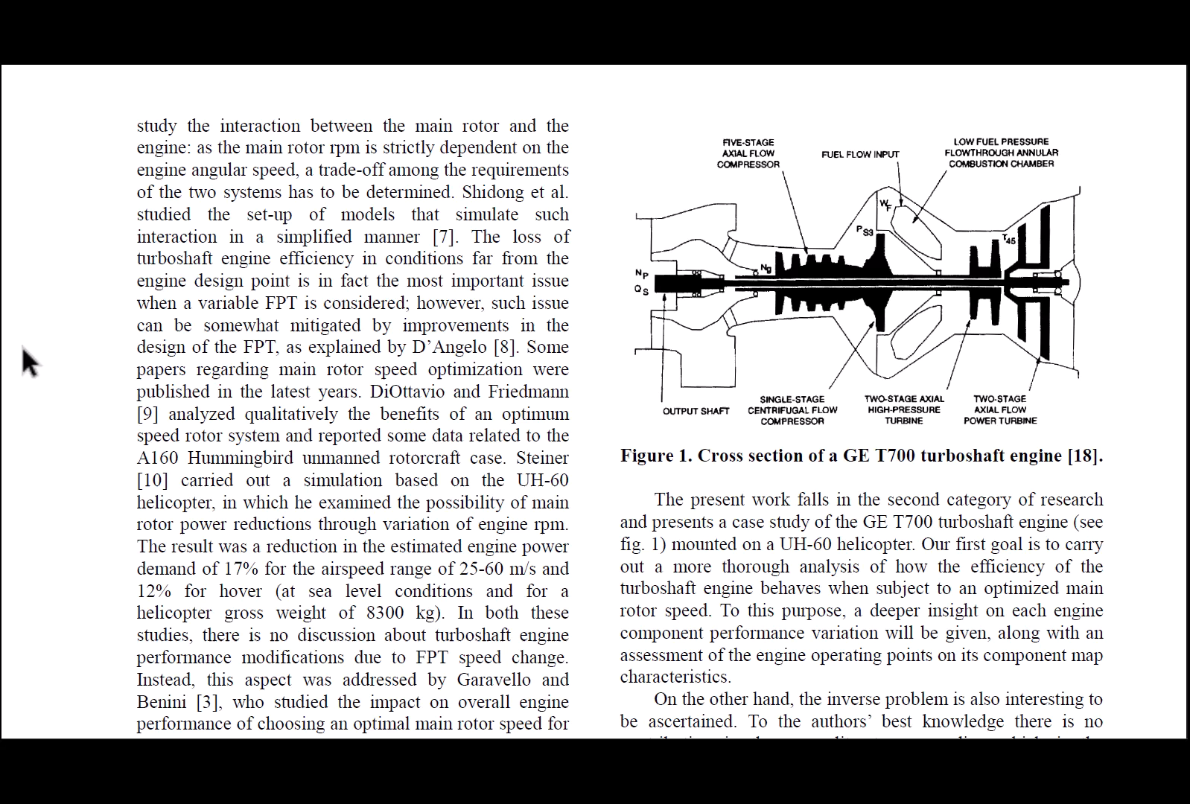

Slide 4
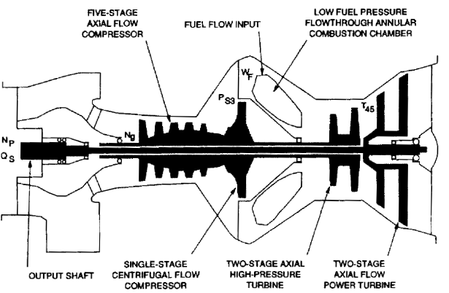
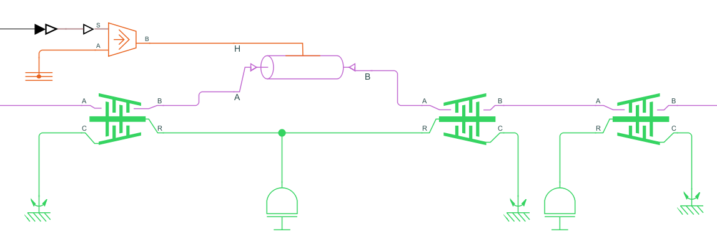
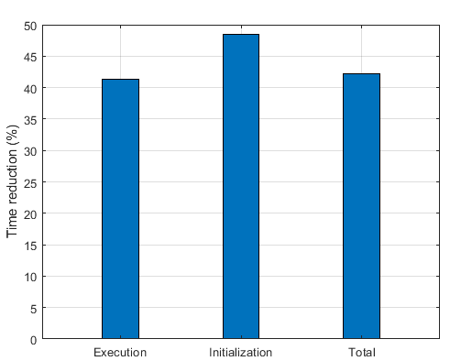
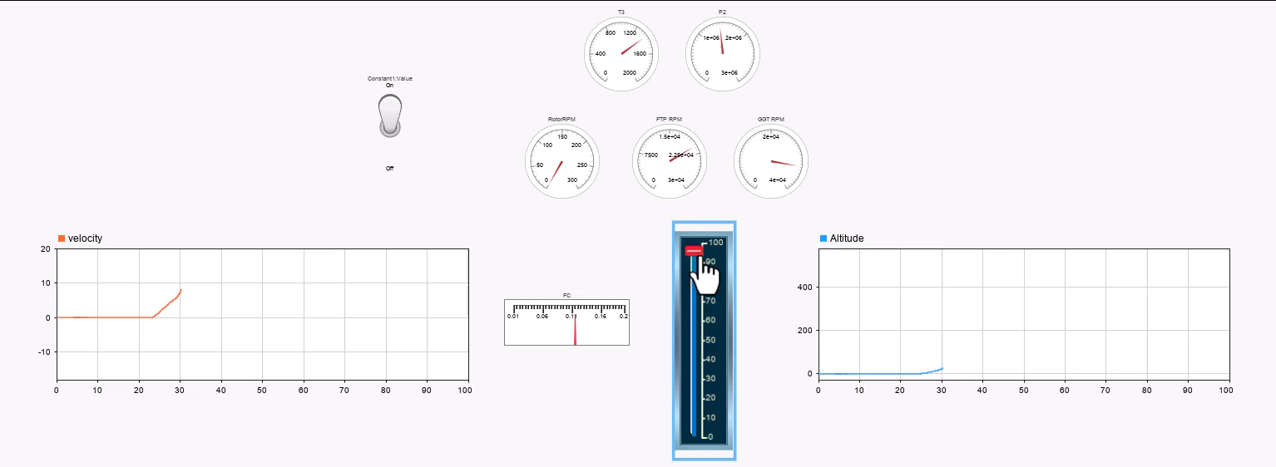
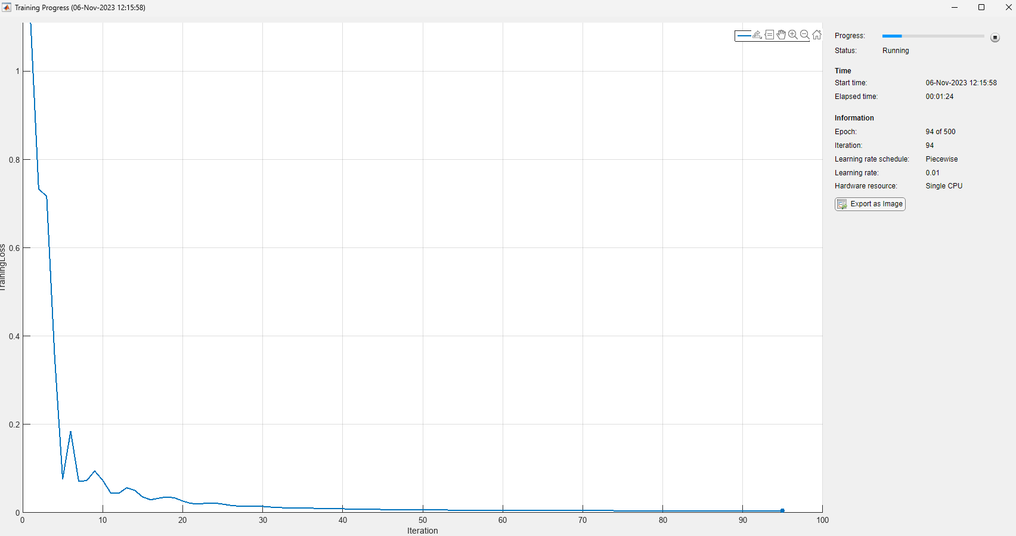
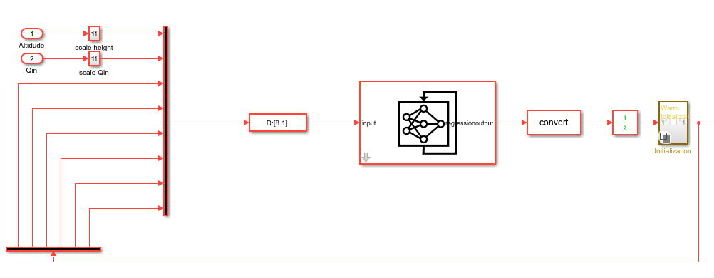
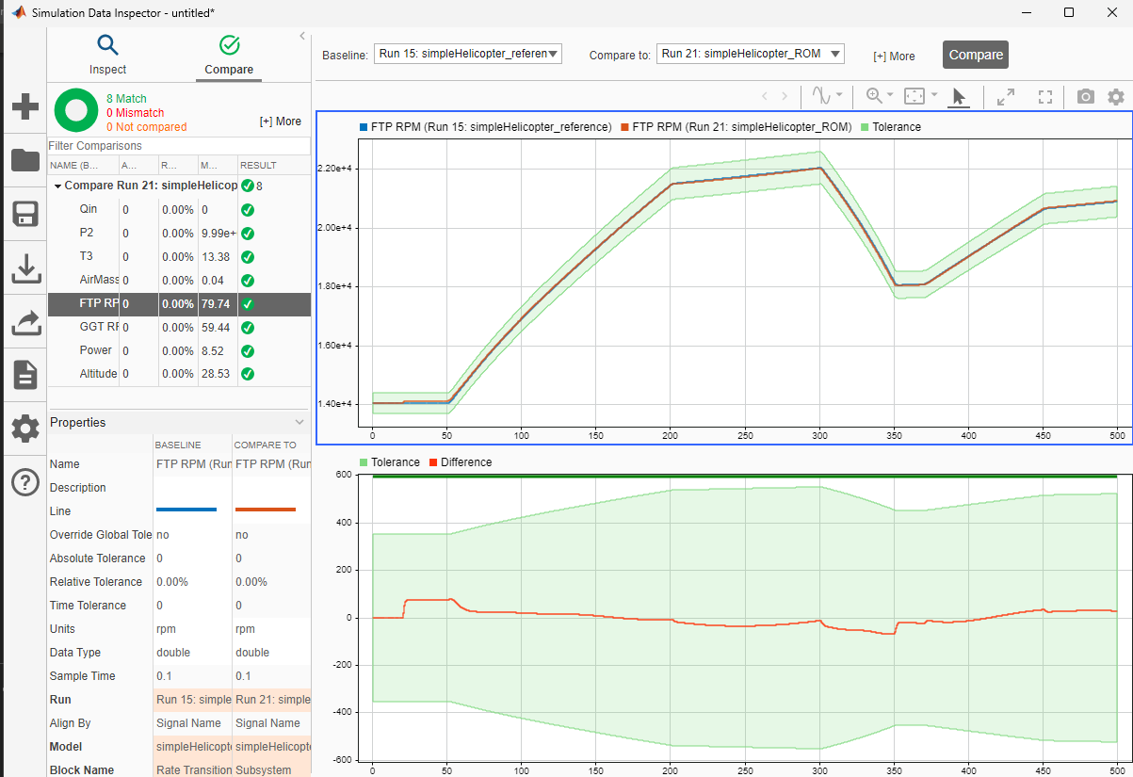
From a published article to real time simulation
Compressor
Compressor turbine
exhaust
estimate TET, Power
model
emulate
Combustion chamber
Power shaft
Free power turbine
reduce
deploy
compare

Slide 5




Conclusion
All in one ecosystem
Model, Reduce, Test, Emulate
Estimate what we cannot measure
Burner exit temperature
Mechanical power
Learn from the experience
Performant ~40% faster
Accurate ~2.5% relative tolerance
Simulate real-time
Hardware in the loop testing
New opportunities:
Predictive maintenance and control
Accelerate prototyping

Slide 6
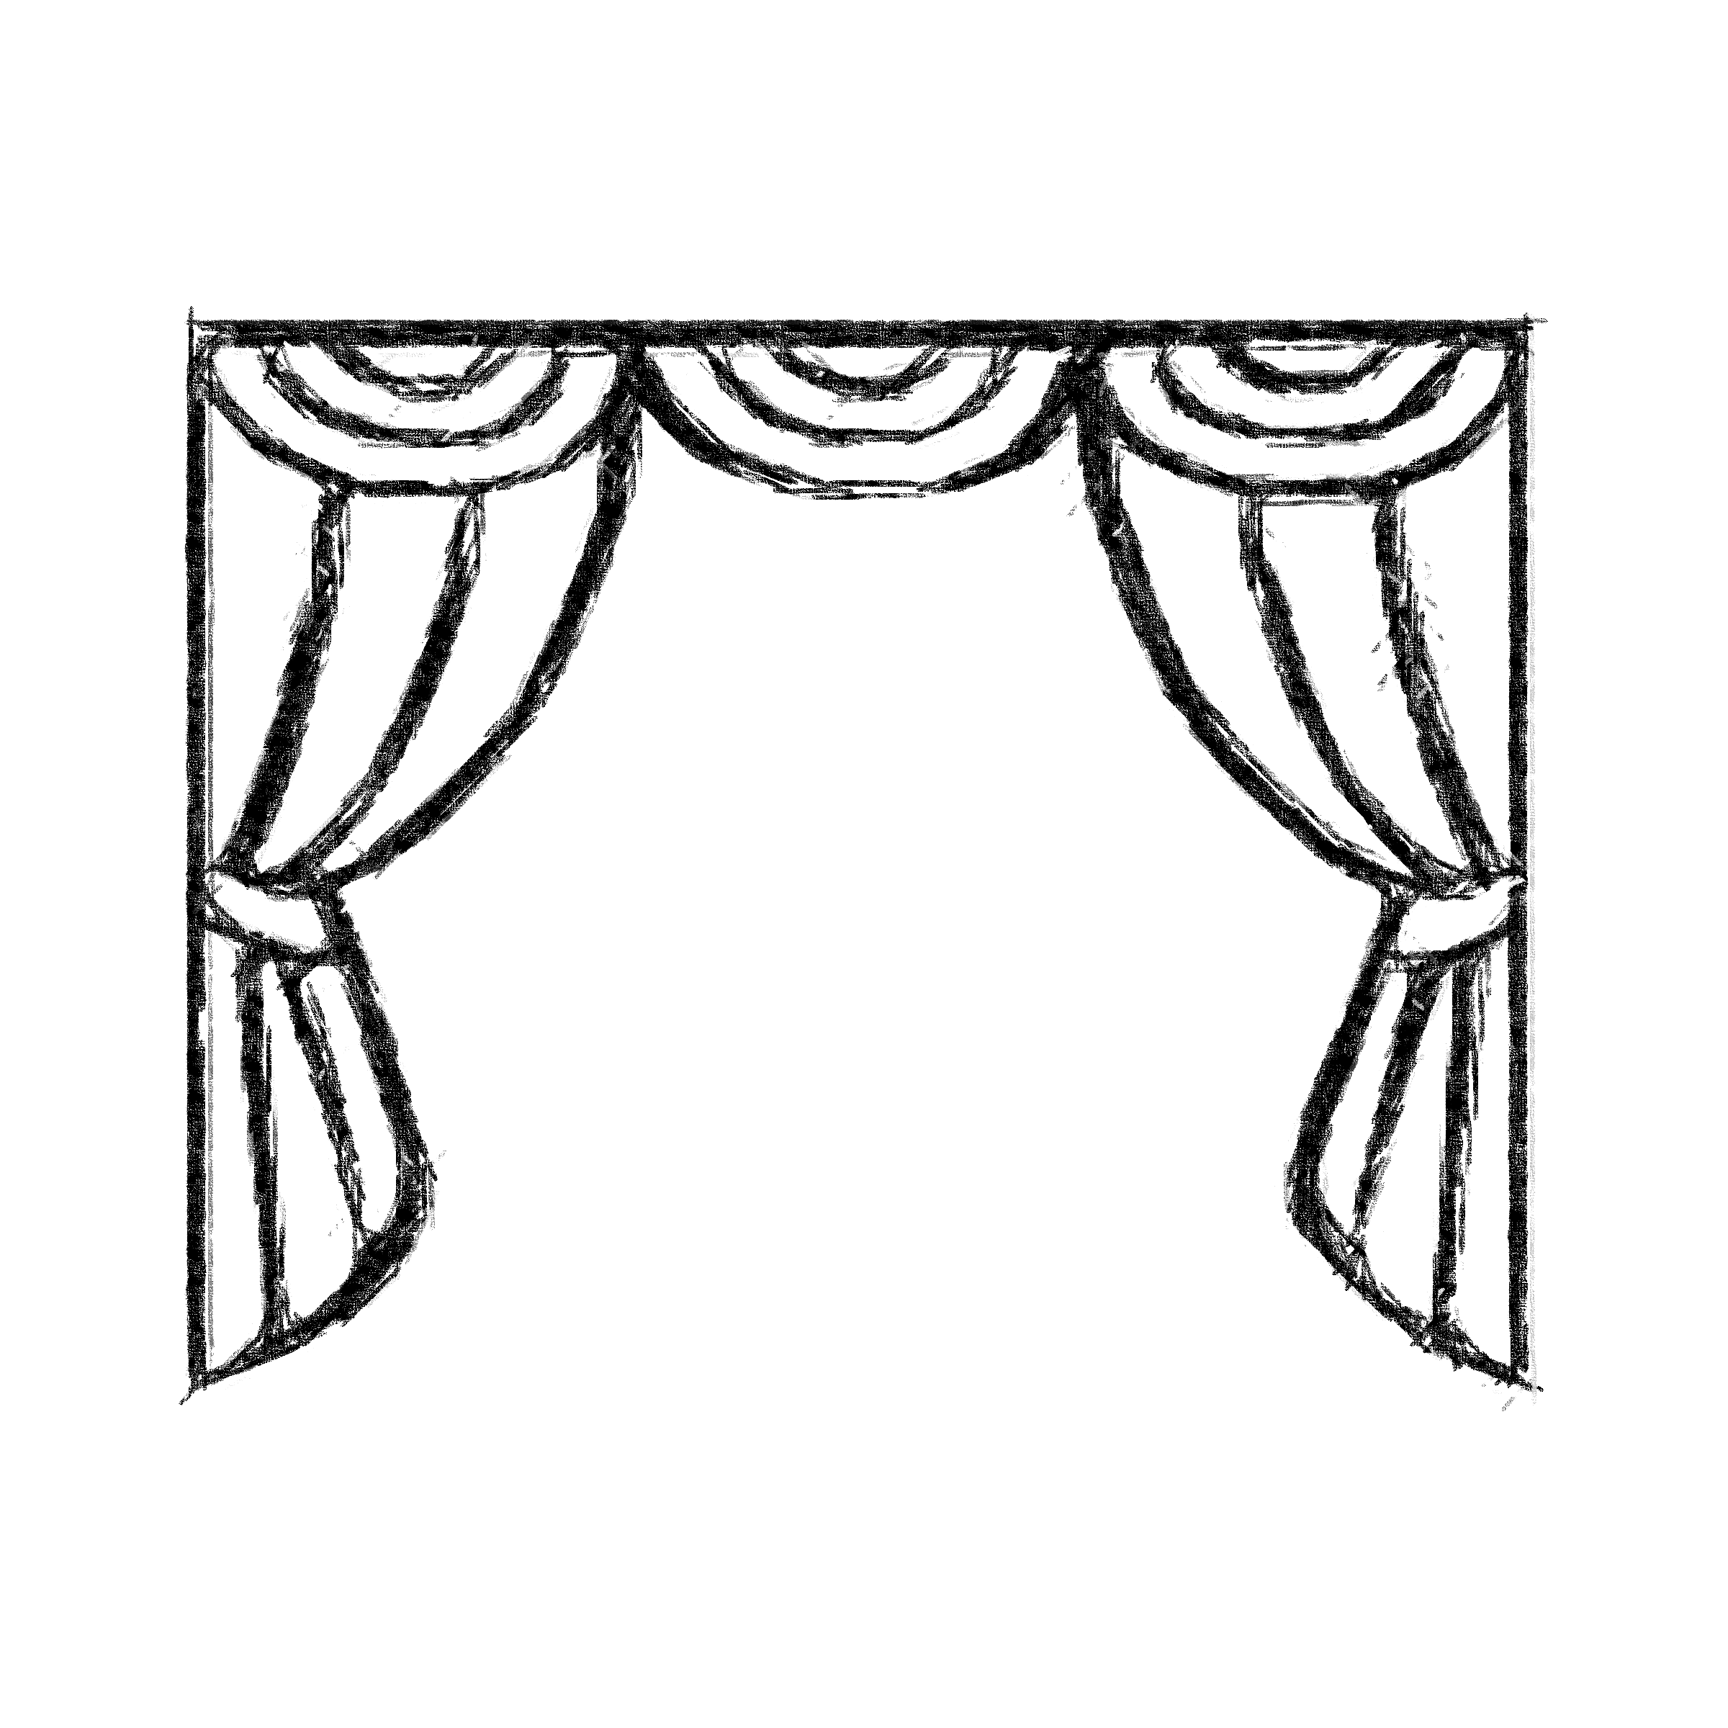




Under the hood
Ramp up
Simulink with Deep Learning
- Where to start
- MATLAB vs Simulink implementation
- Lack of examples
- Documentation gaps
Framework migration - trainnet
Report issues
- Performance
- Accuracy
- Slower training
- Difficulties to report Simulink issues
- Not always time efficient to report issues in MATLAB
Notes:
Ramp up
Where to start
MATLAB vs Simulink implementation
Simulink with Deep Learning
Lack of examples
Documentation gaps
Framework migration - trainnet
Performance
Accuracy
Slower training
Report issues
Difficulties to report Simulink issues
Not always time efficient to report issues in MATLAB

Slide 7




Summary of the project
Demonstrate
Engage
Improve
Bridge
End-to-end workflow
Capabilities of our tools
AIRBUS Webinar
SAFRAN
ALSTON, Schneider Electric?
Products
Documentation
Collaboration
Deep Learning, CDA
AE, ASG

Slide 8
Thank you for your attention! Do you have any questions?
References
[1] Misté, G.A. and Benini, E. (2012) ‘Performance of a turboshaft engine for helicopter applications operating at Variable Shaft Speed’, ASME 2012 Gas Turbine India Conference [Preprint]. doi:10.1115/gtindia2012-9505.
Notes:
What are this project’s goals

Slide 9
DRAFT
Notes:
What are this project’s goals

Slide 10
Under the hood
Ramp up
Where to start
MATLAB vs Simulink implementation
Simulink with Deep Learning
Lack of examples
Documentation gaps
Framework migration - trainnet
Performance
Accuracy
Slower training
Report issues
Difficulties to report Simulink issues
Not always time efficient to report issues in MATLAB

Slide 11
Under the hood
Ramp up
Difficult to understand which information was relevant
What is the equivalence of MATLAB and Simulink implementation
Simulink with Deep Learning
Not many examples
Documentation gaps
Framework migration - trainnet
Not always more performant
Not always more accurate
Slower training
Report issues
Difficulties to report Simulink issues
Not always time efficient to report issues in MATLAB

Slide 12
Under the hood
Ramp up
- Where to start
- MATLAB vs Simulink implementation
Simulink with Deep Learning
- Lack of examples
- Documentation gaps
Framework migration - trainnet
- Performance
- Accuracy
- Slower training
Report issues
- Difficulties to report Simulink issues
- Not always time efficient to report issues in MATLAB

Slide 13
Initial goals
Project Deliverables
Initial reduction workflow by 28/07
LiveScript demonstrating model reduction workflow using LSTM by 23/08
Project presentation by 15/09

Slide 14
Summary of the project
Demonstrate
End-to-end workflow
Capabilities of our tools
Engage
AIRBUS Webinar
SAFRAN
ALSTON, Schneider Electric?
Improve
Products
Documentation
Collaboration
Bridge
Deep Learning with CDA
Aerospace examples

Slide 15
Conclusion
All in one ecosystem
Model, Reduce, Test, Emulate
Learn from the experience
Performant ~40% faster
Accurate ~2.5% relative tolerance
Estimate what we cannot measure
Burner exit temperature
Mechanical power
Simulate real-time
Hardware in the loop testing
Predictive maintenance and control
Accelerate prototyping

Slide 16

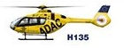


Real time simulations
Real System
Flexible design
Hardware in the loop
Reduced Order Model
Reduced cost
Emulation
Notes:
Les simulations en temps réel de systèmes physiques peuvent ouvrir la voie aux tests matériels en boucle fermée, au prototypage rapide et à la maintenance prédictive, réduisant ainsi les coûts et le temps des systèmes réels. Cependemt Les ressources de calcul limitées constituent une barrière à la complexité des systèmes physiques que nous pouvons simuler en temps réel. C'est là que les modèles à ordre réduit jouent un rôle important en réduisant la complexité avec une précision raisonnable.

Slide 17
Real time simulations
Real System
Flexible design
Flexible design
Reduced Order Model
Reduced cost
Emulation
Notes:
Les simulations en temps réel de systèmes physiques peuvent ouvrir la voie aux tests matériels en boucle fermée, au prototypage rapide et à la maintenance prédictive, réduisant ainsi les coûts et le temps des systèmes réels. Cependemt Les ressources de calcul limitées constituent une barrière à la complexité des systèmes physiques que nous pouvons simuler en temps réel. C'est là que les modèles à ordre réduit jouent un rôle important en réduisant la complexité avec une précision raisonnable.

Slide 18
Conclusion
Model, reduce, test, deploy and emulate in one ecosystem
Learn from the experience
Performant ~60% faster
Accurate ~2.5% relative tolerance
Estimate magnitudes difficult to measure
Simulate real-time and pave the way for
Hardware in the loop
Rapid prototyping
Predictive maintenance

Slide 19
Conclusion
All in one ecosystem
Model, Reduce, Test, Emulate
Learn from the experience
Performant ~60% faster
Accurate ~2.5% relative tolerance
Estimate what cannot measure
Burner exit temperature
Mechanical power
Simulate real-time
Hardware in the loop
Rapid prototyping
Predictive maintenance

Slide 20
Contents
Introduction – AIRBUS invests in AI
Model reduction for Hardware in the loop
Turboshaft Engine in Simulink
Reduced Order Model
Demonstration – Reduced order model with LSTM network
Conclusion

Slide 21
Conclusion
Possible to learn from the experience
LSTM networks are sensitive to data quality
Increase model performance
Accurate response
Areas of attention
Data drifting
Long timeseries
OOD : out of distribution data

Slide 22
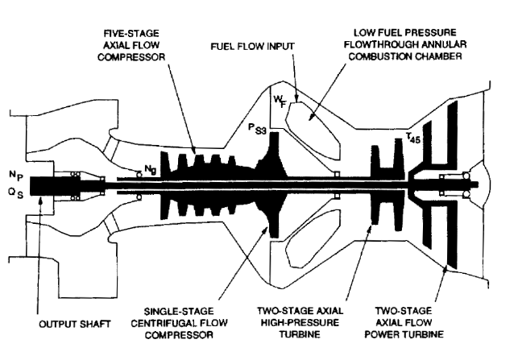
Lessons learned
Model
Emulate
Reduce
Deploy
Compare

